Slide 1
SPEED SESSION
My Business is Your Business
K-16 Pathways

Slide 2
Tyler Shinaberry - EPIK
Life-long learner with an appreciation of early age education and engagement
Exposed, encouraged, and engaged in numerous aspects of industries with father and grandfather throughout childhood
Denied PSCO option in high school; instead, took machine trades at Tri-Rivers not knowing it was not construction equipment
  Goal was set to learn CNC and teach other students in class and outside
  Began the concept behind EPIK to templatize the process and be a holistic one-stop solution provider for business
Became engaged with community objectives for workforce
Took entry level technical and base courses at NCSC but left to pursue business opportunities providing technical support/training for CNC company
Market collapse closed CNC company; placed efforts on keeping orphaned customers in operation
As a solution company was guided that my ideas on workforce shortage were spot on and the true need of my business was for it to go beyond applying the advanced mechatronic, holistic solutions I had in my arsenal, an to build a workforce capable of applying it to all
Volunteer and paid consultant to numerous organizations focused on bettering their communities, industry sectors, education, and youth/adults who need the opportunity to be empowered and enriched

Slide 3
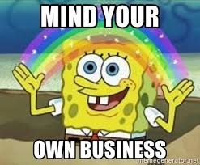
When too much of a good thing… becomes a bad thing.

Slide 4
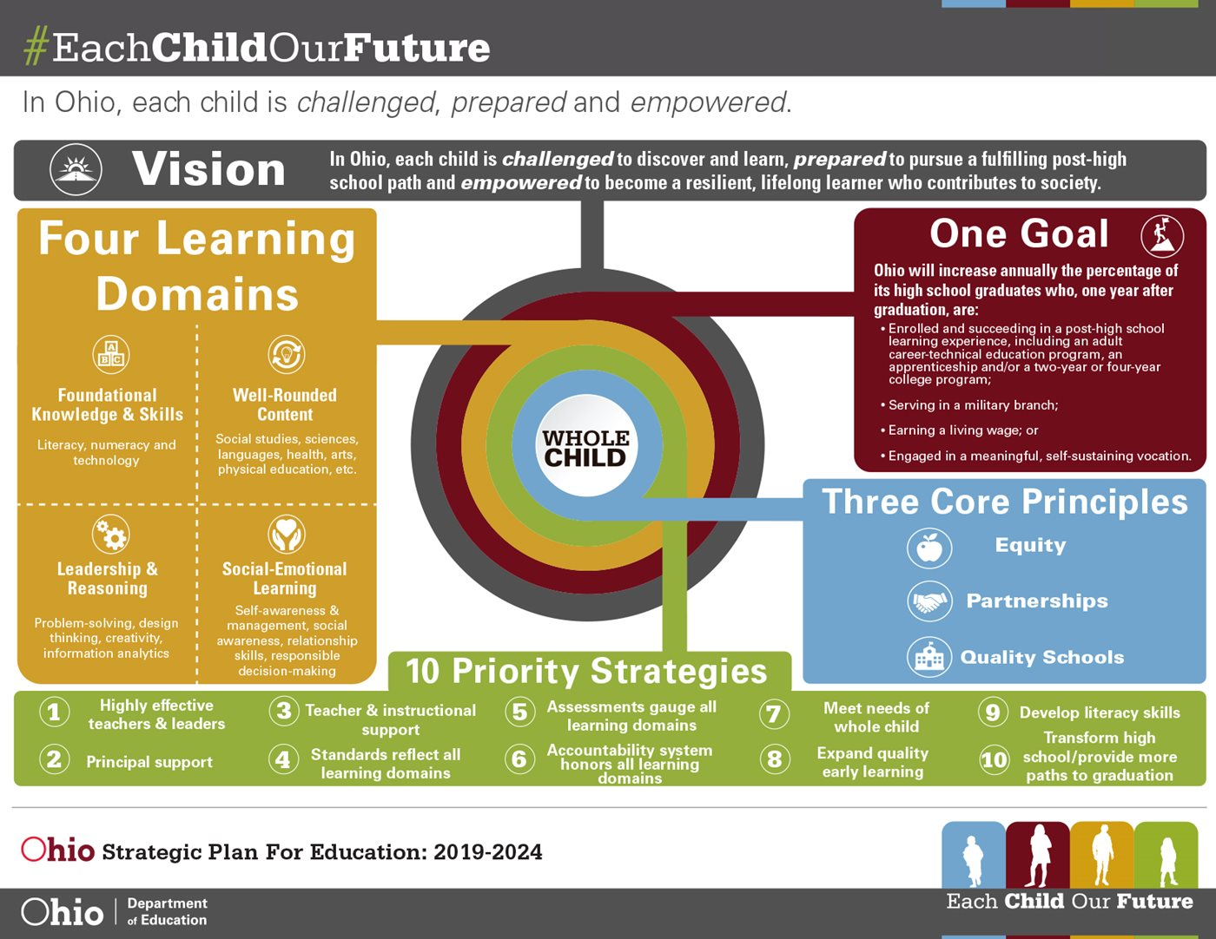
Making Information Available
The Old Way – Linear Flow
The New Way – Cyclical Disruption
1
2
3
4
5
6
7
8
9

Slide 5

My Business is Your Business
Carries Two Meanings
1) As a holistic business, we have made it our business model to reach out to educators, businesses, families, community leaders, and policy makers to solve the essential and hard skill challenges facing employer
2) Students, now more than ever must be able to make a connection between what they are being taught and its application in today’s modern industries. It is the responsibility of businesses, families, community leaders, and policy makers to break down silos, look past assumptions, and make connections between activities.

Slide 6
Fast Paced but Interactive
3 Days of Effort and 100+ Slides Later…
Rule #1: Work with existing efforts from ODE to align business and education efforts. This goes from industry recognized credentials to using approved pre and full apprenticeships/ Career Pathways
As a result, settled on using the existing career connections framework and sharing success stories we are having at each of these fundamental stages.
Goal is to get the creative juices flowing for all members of the audience whether you are an educator, administrator, community leader, or policy maker. Each of us have individual needs, EPIK can help!

Slide 7
Career Technical Education for K-16
Using Career Connections, students can build a post graduation pathway that fulfills one of Ohio’s “4 Es”:
Enrolling in further education
+1; +2; +4; or more
Enlisting in the military
Employment (hire and/or continued apprenticeship)
Engaged in a self-sustaining vocation such as the peace corps

Slide 8
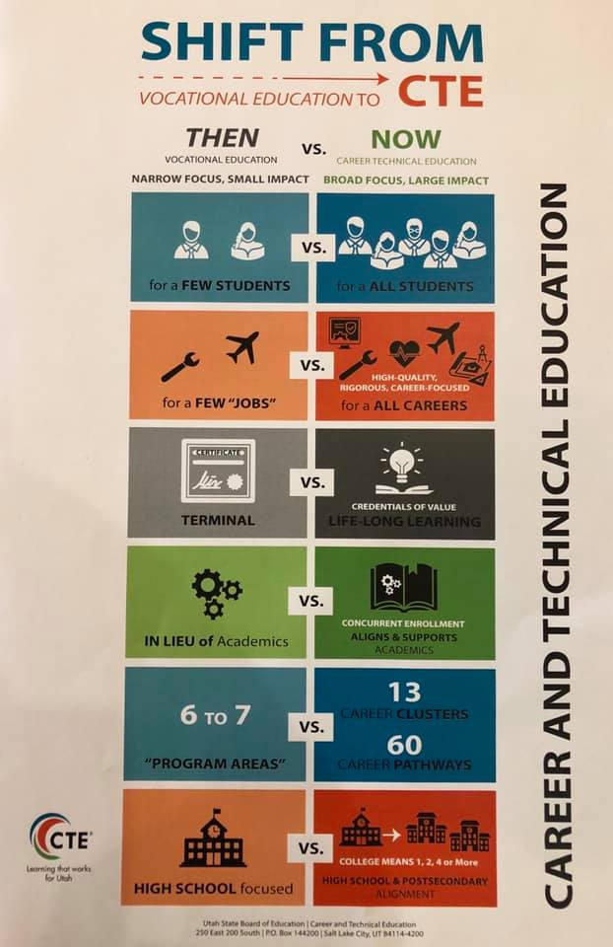
SHIFT FROM VOCATIONAL EDUCATION to CTE

Slide 9
for a FEW STUDENTS vs. for ALL STUDENTS
For a FEW “JOBS” vs. for ALL CAREERS
High-Quality; Rigorous; Career-Focused
Terminal vs. Credentials of Value LIFE-LONG LEARNING
IN LIEU of Academics vs. Concurrent Enrollment
Aligns & Supports Academics
6 to 7 “Program Areas” vs. 13 Career Clusters / 60 Career Pathways
Even more in Ohio!
High School focused vs. COLLEGE MEANS 1, 2, 4 or MORE!
Shift from Vocational Education to CTE

Slide 10
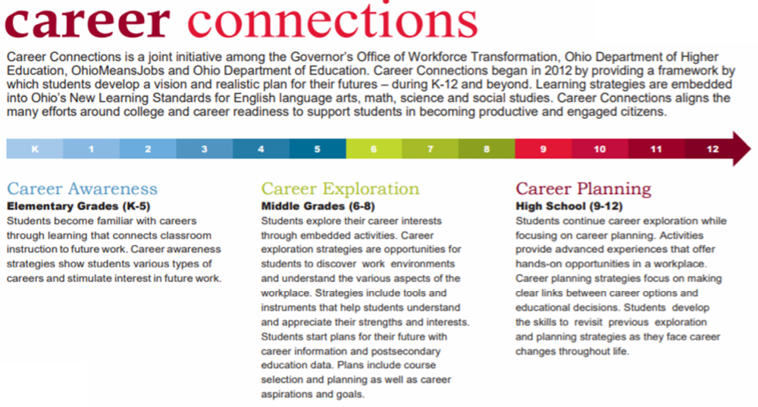
http://education.ohio.gov/Topics/Career-Tech/Career-Connections/Career-Connections-Framework

Slide 11
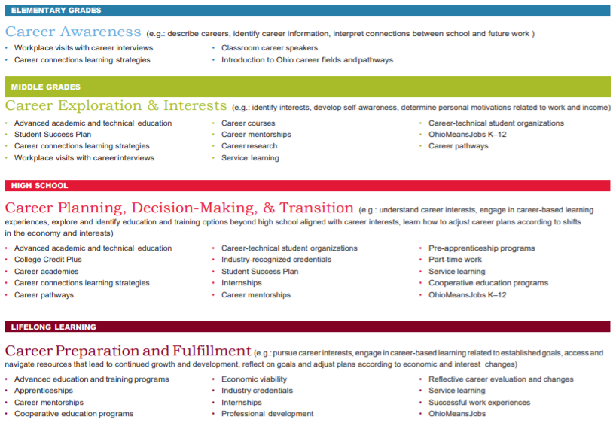

Slide 12

Grades K-5

Slide 13

Grades K-5
Working with employers to create onsite visits for educators to tour and explore facilities and give them curriculum that covers multiple subjects back with them
Use of NCO Industrial Museum and Little Buckeye Career Museum to build hands-on displays
Students entering 5th grade have an opportunity to participate in Summer Manufacturing Institute

Slide 14
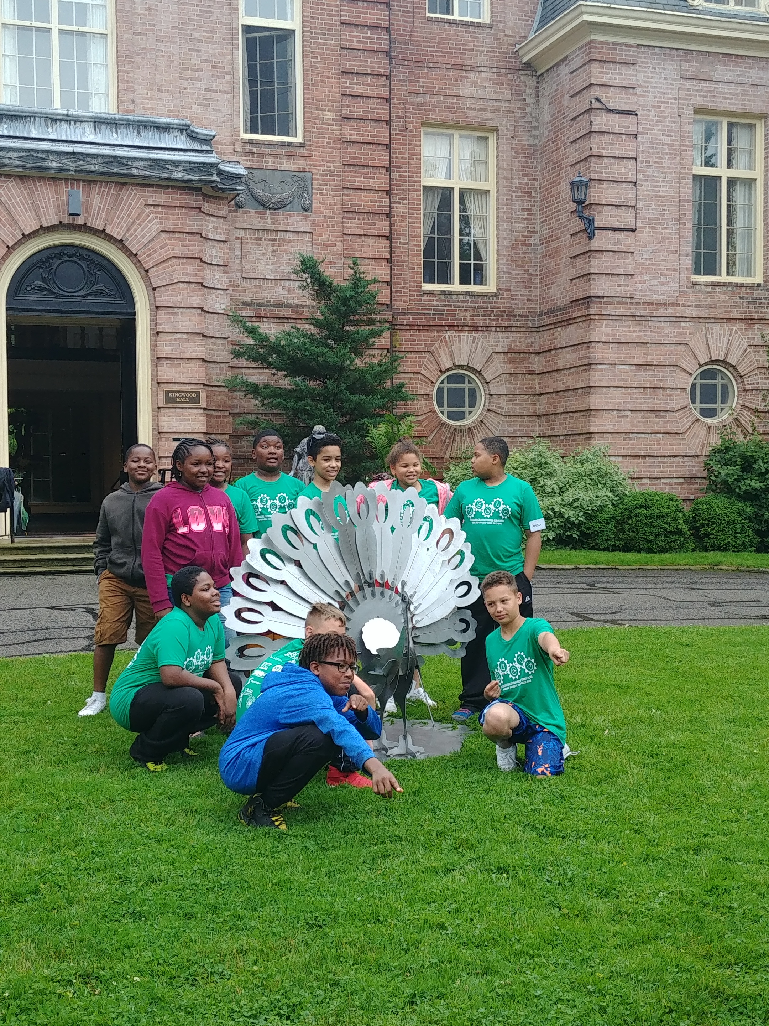

Slide 15
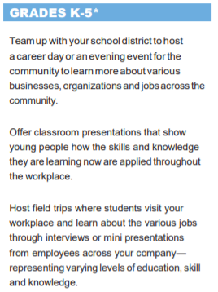
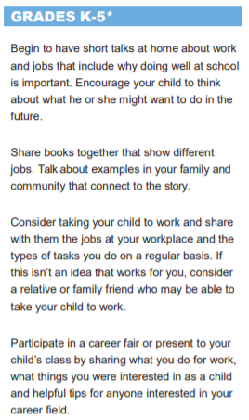
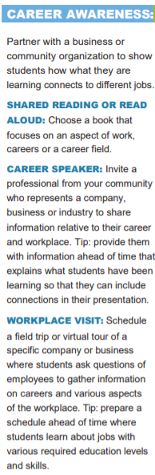
Business
Parents
Education

Slide 16
Grades 6-8

Slide 17
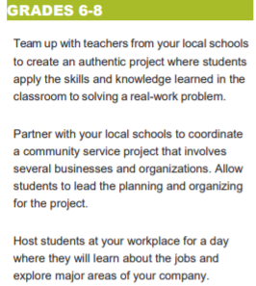
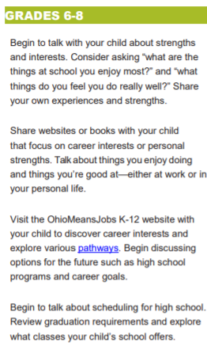
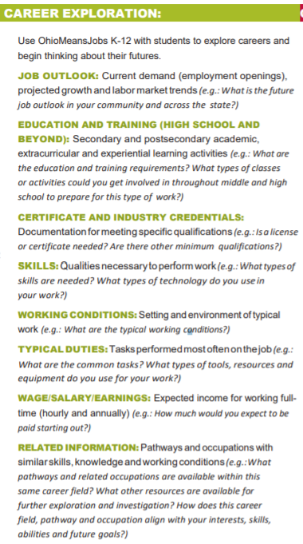
Business
Parents
Education

Slide 18
Grades 9-12

Slide 19
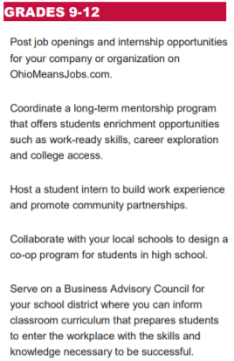
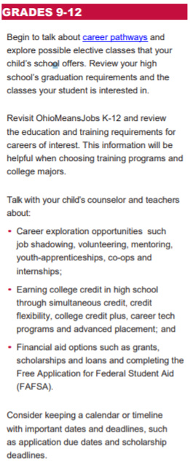
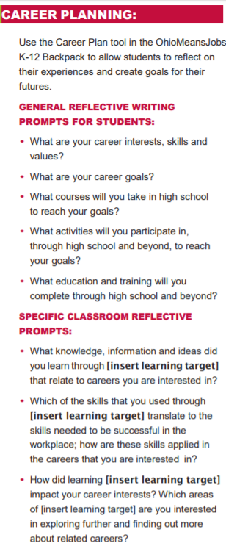
Business
Parents
Education

Slide 20

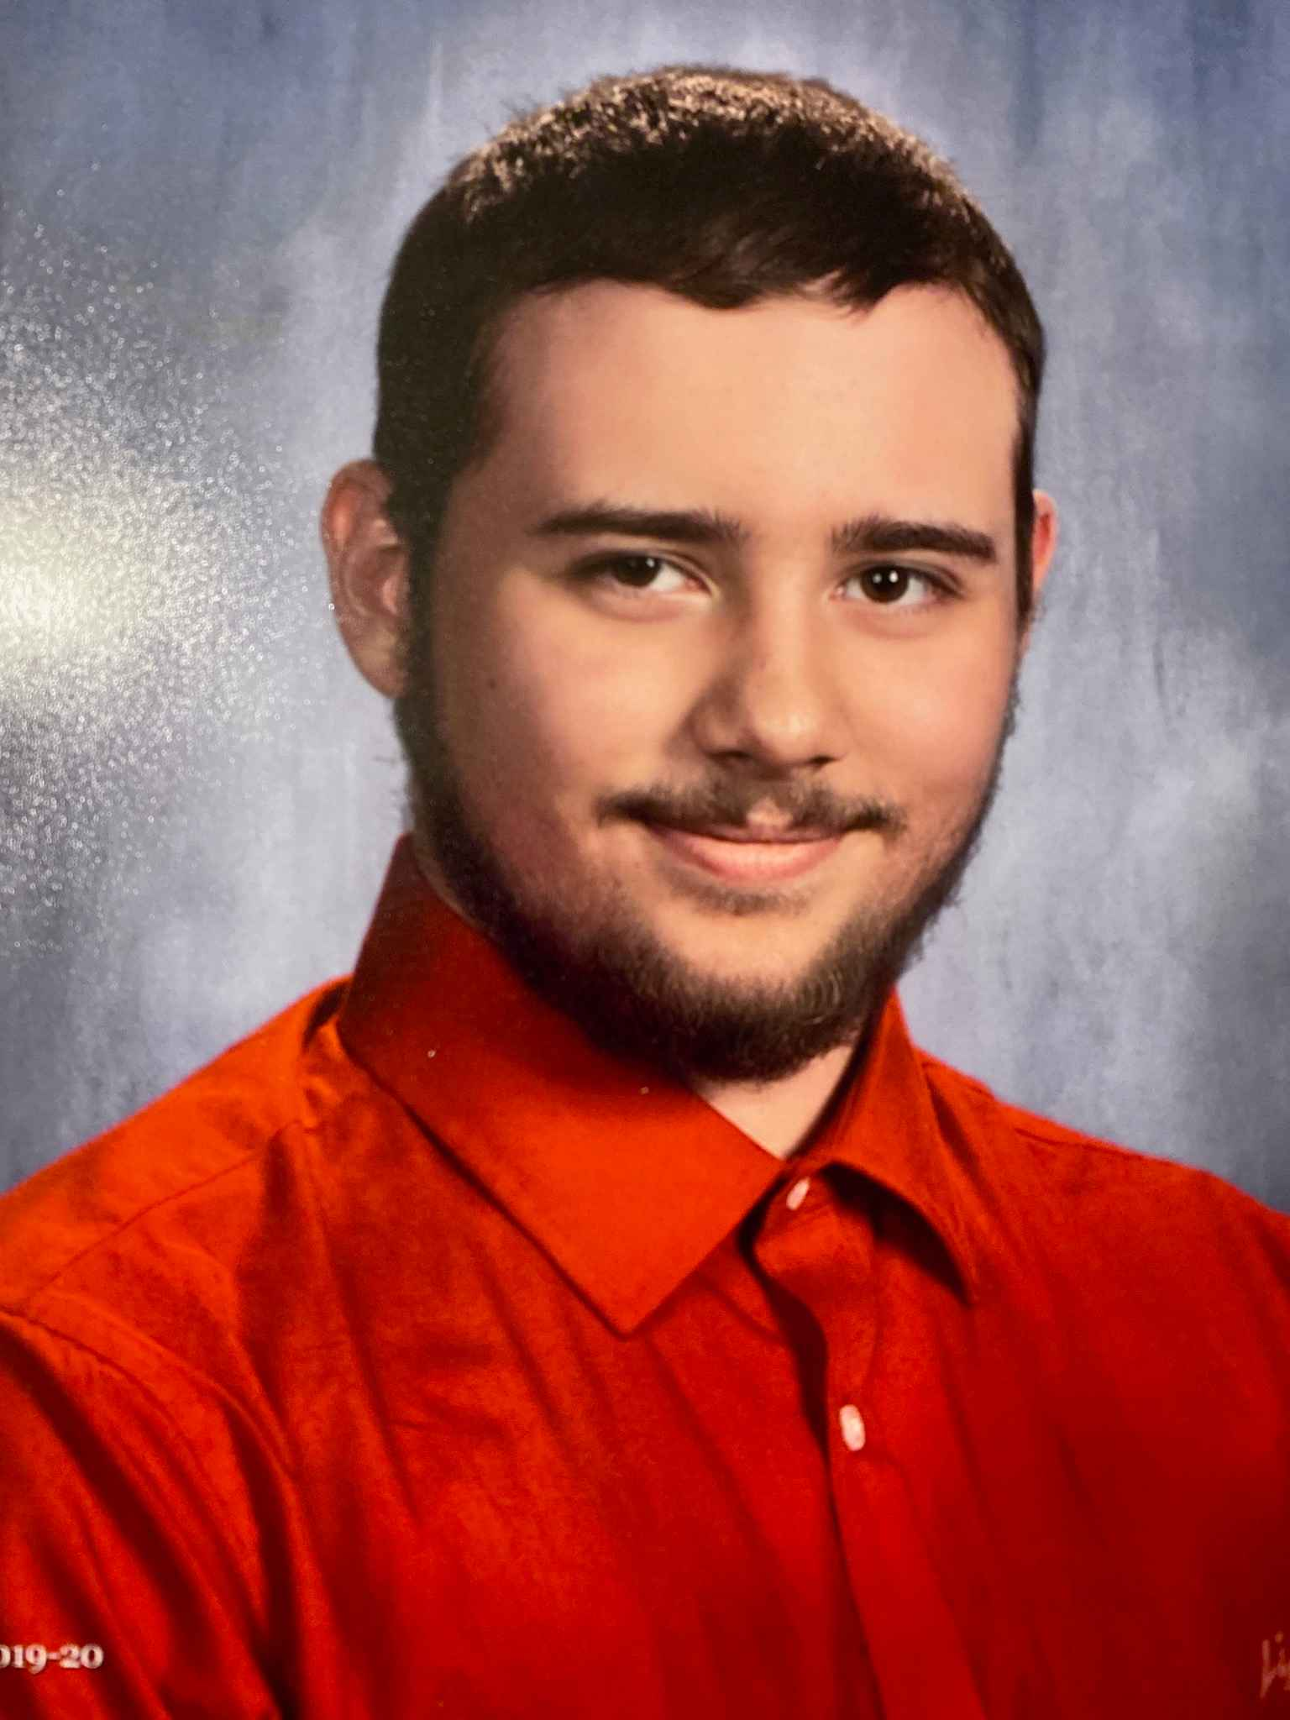
The John Ferguson Story
Grades 7-16

Slide 21

John was in the 7th grade and had an interest in aircraft due to an uncle working at SpaceX. He also wanted to make a custom racecar part and knew that machining/fabrication was necessary
At the end of 7th grade John went to LeaderRichland (local career exploration at college branch)
He took EPIK’s 25 minute class on manufacturing opportunities which included a hands-on CAD activity of making a 3D coin with the school’s mascot
  John was currently taking AutoCAD but became excited at the future possibilities
John took the remaining drawing classes in 8th grade
In 9th grade he was able to take an exploratory engineering class
In 10th he completed the last available engineering related class
  He was then told his options were career center or being bored with remaining traditional classes
John recalled me discussing a program called College Now (www.College-Now.org

Slide 22
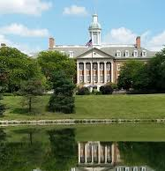
John’s father called me and we discussed the opportunity
John overcame his math shortage (due to the program not being planned) and was able to pass his admissions test and was able to join
He will be graduating with his calculus-based Engineering Tech Associates Degree prior to receiving his diploma this May
John will be attending Ohio State University for Grades 14-16 to receive a bachelors degree in business-based engineering

Slide 23
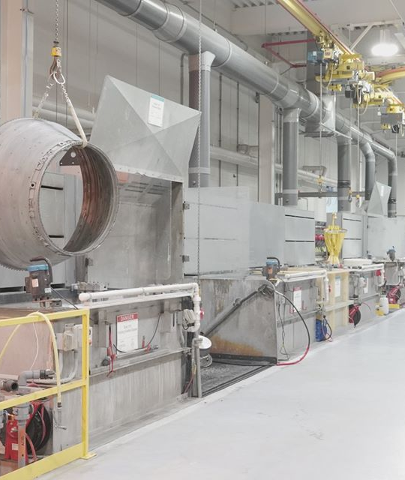
This summer John is slated to attend the SOAR program from CRT, an aerospace component company that repairs turbine engines
  The SOAR program will pay him a very generous wage; house him; create a mentor-based program that will waive probationary hiring time
CRT will work with John as they encourage continued education
John will be invited to join the following summer as well
Upon completion of school, John will have the opportunity to work for CRT
  CRT benefits are unbelievable with high school diploma level employees (trained internally) making 6-digit incomes with tuition reimbursement; virtually no insurance deductible care; profit sharing; retirement plans; and much more
John will be 20 with multiple credentials, degrees, a Bachelors, and virtually limitless opportunity to expand in a growing company

Slide 24
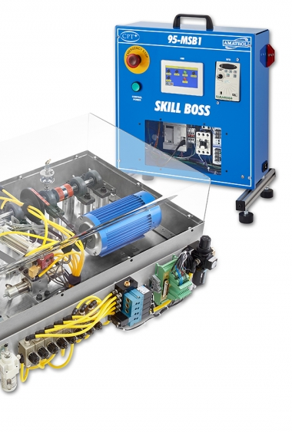
Select Current Projects
EPIK is continuously building upon strong Career Connection solutions
Recent activities are:
Helping a school develop an internal CTE solution for its region
Bringing an industry recognized credential to 8-10th grades and/or 11-12 as well as adults
  Solution can be reimbursed by state
Making the connection between an industrial training system and getting companies to pay for and make the connections for the school
  This program equates to multiple credentials
  AFL-CIO recognized pre and full apprenticeship
  Industry recognized credential totaling 12 points +
Promotion of an essential skill/leadership program endorsed by OSU Alder Enterprise (3 points across all pathways)
Join us this afternoon for the Career Path Less Taken video + Q&A which builds upon these connections w/ program manager Celena Roebuck

Slide 25




Thank You for Your Participation!
Join us this afternoon w/ Celena Roebuck as we present The Career Path Less Taken.
This hour long video segment + Q&A will build upon this morning’s speed session.
My Contact Information
Tyler Shinaberry
Applied Technology & Workforce Specialist
tyler@epikltd.com | 866-928-5167

